Slide 1
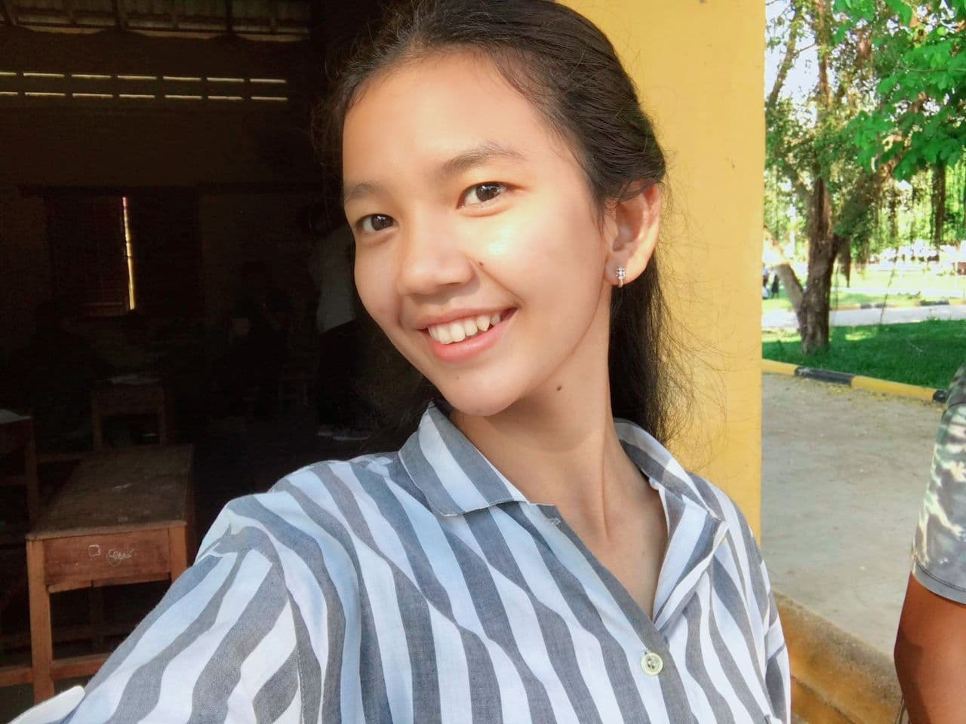
Where do you want to go?
Hello, konnichiwa
my name is Thida!☺

Slide 2
Vocabulary = វាក្យស័ព្ទ
កន្លែងណា =where
ចង់ =want
ទិញ =buy
នំបុ័ង =bread
ផ្សារទំនើប =mall
អាហារពេលថ្ងៃ =lunch
ចម្អិនម្ហូប =cook
ខ្លួនឯង =yourself

Slide 3
where តើកន្លែងណា
Where តើកន្លែងណា
Want ចង់
Want ចង់
go ទៅ
go ទៅ
Where do you want to go?
តើអ្នកចង់ទៅកន្លែងណា?

Slide 4
Check it!
តើកន្លែងណា
Where
ចង់
Want
តើអ្នកចង់ទៅកន្លែងណា?
Where do you want to go?

Slide 5
Where do you want to go? តើអ្នកចង់ទៅកន្លែងណា?
តើអ្នកចង់ទៅកន្លែងណា?
Where do you want to go?
Where do you want to go?
ខ្ញុំចង់ទៅផ្សារទំនើប Lucky។
I want to go to Lucky Mall.
I want to go to Lucky Mall.
ខ្ញុំចង់ទៅទិញនំបុ័ងនៅទីនោះ។
I want to buy bread there.
I want to buy bread there.

Slide 6
ខ្ញុំចង់ទៅទិញពែង ramen សម្រប់អាហារថ្ងៃត្រង់។
I want to buy cup ramen for lunch.
I want to buy cup ramen for lunch.
តើអ្នកអាចចម្អិនម្ហូបដោយខ្លួនឯងបានទេ?
Can you cook by yourself?
Can you cook by yourself?
ខ្ញុំអាចចម្អិនវាបានយ៉ាងងាយ។
I can cook it easily.
I can cook it easily

Slide 7
Check it!
តើអ្នកចង់ទៅកន្លែងណា?
Where do you want to go?
ខ្ញុំចង់ទៅផ្សារទំនើប Lucky។
I want to go to Lucky Mall.
តើអ្នកចង់ទៅកន្លែងណា?
Where do you want to go?
ខ្ញុំចង់ទៅផ្សារទំនើប Lucky។
I want to go to Lucky Mall.

Slide 8
Interaction Where do you want to go? Repeat 2 or 3 times in order
Where do you want to go？
I want to go to Japan.
Where do you want to go？
I want to go to Lucky Mall.
Where do you want to go？
I want to go to Siem Reap.
Where do you want to go？

